Slide 1
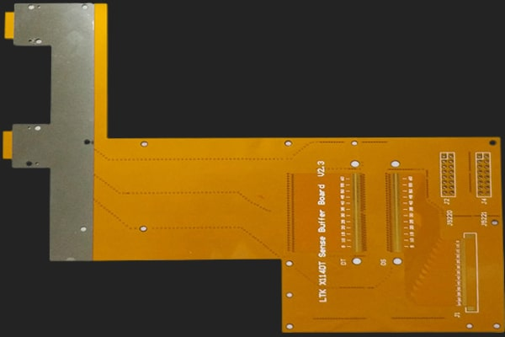
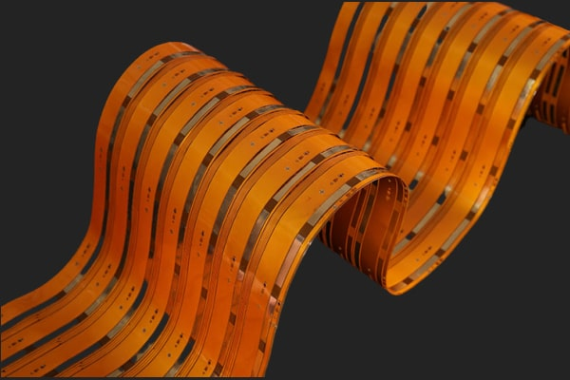
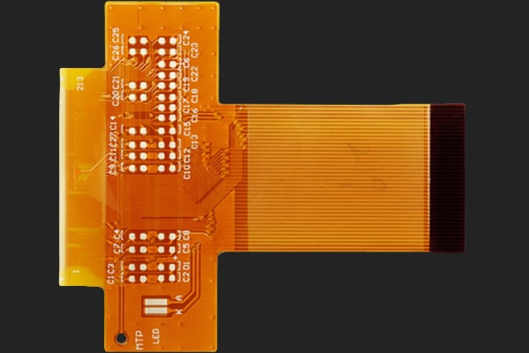
Full Feature Flex PCB Board Manufacturer – Https://www.pcbelec.com
What is flexible PCB and its manufacturing process
What is Flexible PCB?
Flexible circuit board, also known as "FPC," is a printed circuit made of a flexible insulating substrate. Flexible circuits provide excellent electrical performance, meet the design needs of smaller and higher-density mounting, and help reduce assembly processes and enhance reliability. Flexible circuit boards are the only solution to meet the miniaturization and movement requirements of electronic products. It can be bent, wound, and folded freely and withstand millions of dynamic bending without damaging the wire. It can be arranged arbitrarily according to the space layout requirements. It can be moved and stretched arbitrarily in three-dimensional space to integrate component assembly and wire connection. The flexible circuit board can significantly reduce the volume and weight of electronic products and is suitable for developing electronic products in the direction of high density, miniaturization, and high reliability.

Slide 2
Flexible PCB Manufacturing Process
Full Feature Flex PCB Board Manufacturer – Https://www.pcbelec.com
Single-sided Flexible PCB Manufacturing Process
Cutting
Drilling
Dry Film Lamination
Position and Exposure
Develop
Coverlay Lamination
Surface Finish
Remove Dry Film
Etching
Lamination
Curing
Surface Finish
Immersion Gold
Silkscreen
Shipment
Packaging
FQC
Punching
Electrical Test
V-cutting/scoring

Slide 3
Flexible PCB Manufacturing Process
Full Feature Flex PCB Board Manufacturer – Https://www.pcbelec.com
Double-sided Flexible PCB Manufacturing Process
Cutting
Drilling
PTH
Electroless Plating
Pretreating
Dry Film Lamination
Pretreating
Remove Dry Film
Pattern Plating
Develop
Exposure
Position
Dry Film Lamination
Position and Exposure
Develop
Etching
Remove Dry Film
Immersion Gold
Curing
Lamination
Coverlay Lamination
Surface Finish
Silkscreen
V-cutting/scoring
Electrical Test
Punching
FQC
Shipment
Packaging

